Slide 1
Broadcast and multicast routing
A superb presentation from
Joakim Lundmark and Martin Neuman

Slide 2
What is broadcasting and multicasting?
Broadcasting
Send to every user in a network
Multicasting
Send to specific users in a network

Slide 3
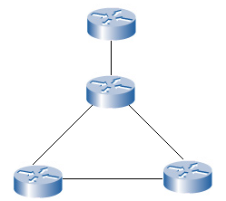
Broadcasting routing
N-way-unicasting
Most straightforward way to send a broadcast packet, to each destination is to make N copies, one for every user. And then send one to each user.
Drawback: use a lot of bandwidth for one line.

Slide 4
Broadcasting routing
Network duplication
Using the network to create and distribute the copies.
Flooding, sending to all neighbors in the network.

Slide 5
Broadcasting routing: Flooding
Uncontrolled flooding
A fatal flaw with flooding.
All nodes have two neighbors: Will broadcast packages indefinitely.
More then two neighbors: Will create a broadcast storm.

Slide 6
Broadcasting routing: Flooding
Controlled flooding
SNCF(Sequence-number-controlled flooding)
Every sender node puts its address and broadcast sequence-number in the broadcast packet.
Every node has a memory of the address and number of each packet it has duplicated and sent.
If it receives a packet in the memory it drops the packet. If not it forward-copy it to its neighbors.

Slide 7
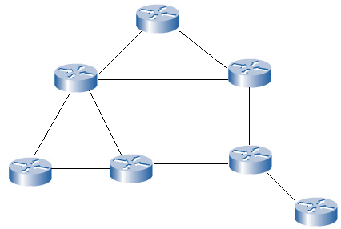
Broadcasting routing: Flooding
Controlled flooding
RPF (Reverse path forwarding)
Only sends packet forward if it is received from the next node in the shortest path back to the sender.

Slide 8
Broadcasting routing
Spanning-Tree Broadcast
Limits number of sent packets.
Creates a path for each node to forward received packets. A so called minimum spanning-tree.
This is done by routing algorithms.

Slide 9
Broadcasting routing
Creating a center based spanning-tree
A central node is defined.
Then all nodes sends a message at the same time towards the center node until they arrive at ether the center node or a node that’s already a part of the tree.

Slide 10
Broadcasting routing
Spanning-Tree Broadcast

Slide 11
Multicasting
Specific receivers
How to identify the receivers of a packet.
How to address a packet sent to these receivers.
You can not have all the addresses in the packet because it would be to big.
A multicast packet is sent by address indirection.
A single identifier for all the receivers.
This is done by a multicast group.

Slide 12
Multicasting
Managing a group
IGMP(Internet group management protocol).
Provides the means for a host to inform the router that it wants to join a multicast group.
It has 3 message types, used for management of the group.
Membership_Query For joining the group
Membership_Report For acknowledgements
Leave_Group For leaving the group

Slide 13
Multicasting routing algorithms
Multicasting routing using a group-shared tree.
Similar to the spanning-tree broadcast.
May use nodes not in the group to “jump” between different parts of the group.

Slide 14
Multicasting routing algorithms
Multicasting routing using a source-based tree
Using a RPF(reverse path forwarding) algorithm each node gets its own spanning tree.
This is better when many users wants to communicate with many users.

Slide 15
Questions?

